Slide 1
Programming #4, 2026
Exercise #4: Bootstrap

Slide 2
Profile page with Accordion
This exercise is a competition among all the project groups.
You will be working as a group to complete this exercise.
You must create the ”Hayao Miyazaki Profile” page, as shown in the next slide
The page MUST be created using Bootstrap.
Use only the topics that were covered in the lecture
You are free to use CSS to make the page visually more attractive.
IMPORTANT: Create an Accordion. Try to be creative.
The page MUST be responsive.
Do not use any AI tool to generate your code. DO IT YOURSELF. I WILL CHECK.
AI can be used for help, when you are stuck, but you MUST state in your code where and why you used it.
The winner of the competition will be announced after the holidays.

Slide 3
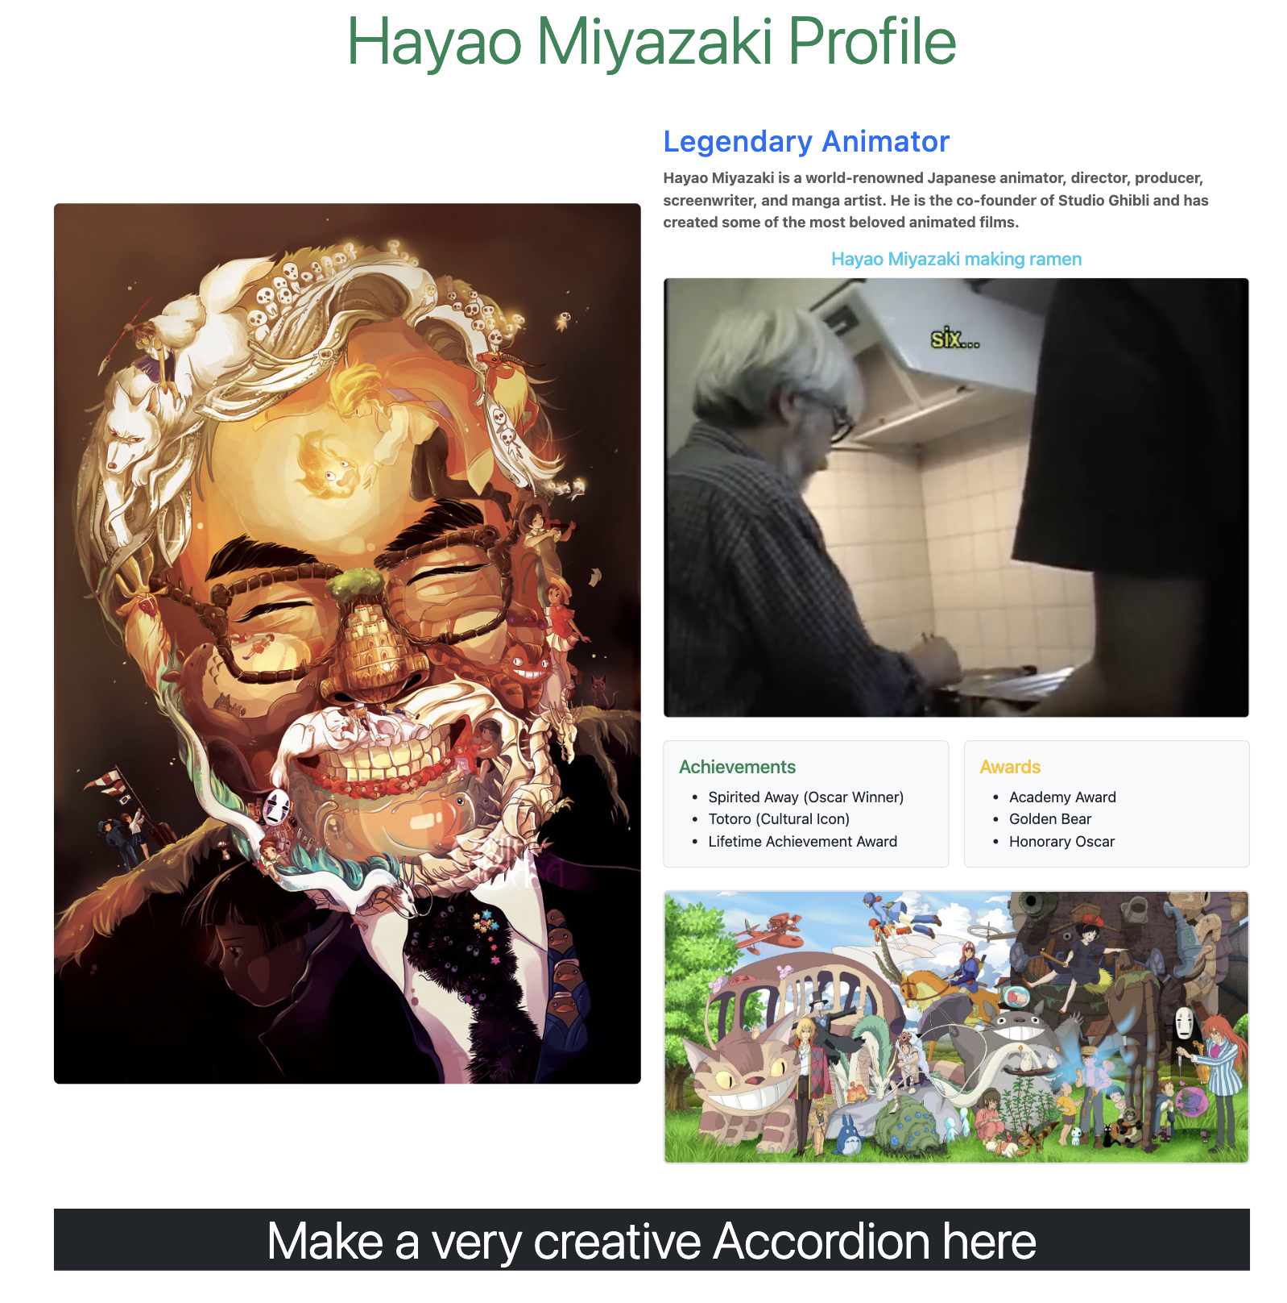

Slide 4
How I will evaluate
I will first evaluate if the page has all the parts as shown in the previous slide
Then I will evaluate the creativity in your Accordion.
If I like both the above, then I will look at the code to make sure all the rules were followed
If I find any BS concept that was not part of the lecture, then that submission will not be included in the competition
If I suspect AI was used in coding, then I will enquire further, and everyone in the suspected group may end up getting -5 points.

Slide 5
Submission Instructions

Slide 6
Submission
Follow the same process as before.
Committ and push your code in GitHub
Host it on GitHub Pages to produce your own github.io link
Submit that link in Moodle’s Exercise #4: Bootstrap submission box
Only one member from every group submits
IMPORTANT: When submitting, state the name of your group and all the members’ names
Deadline: Tomorrow, April 29, 12:00 PM (Noon)

Slide 7
That’s all for this exercise

